Slide 1
Communities
Fahrenheit Co.
Rishabh Tewari - Gantt and Individual Tasks
Eric Anderson - Diagrams
Zoe Chamlee - Specifications
Christopher Bednarz - Pseudo Codes
James W. Garrett - Standards & Conclusion Mason Holley - Objectives & Functionality
Notes:
Presentation: Will

Slide 2
Objectives
Create an application to connect with people within the local scene.
Diversify from similar platforms by filtering visibility to a user’s location.
Encourage participation in local communities via local events
Allow any user to start a group and recruit others within the local scene.
Create tools to maintain and moderate that community.
Cultivate healthy user-base through continuous app growth.

Slide 3
Functionality
Provide account creation and tools, including a membership system
Provide community creation and management tools
Individual community message boards
Ad and premium memberships for monetization purposes
Filters for relevant communities based on search parameters and location
Community event scheduler to communicate to all users in a community

Slide 4
Specifications
Database: MariaDB
Server Storage: 25 GB
Hosting Service: Linode
Hosting Service Expense: $5/month
Web Framework: Revel
Frontend Development: React
API:

Slide 5
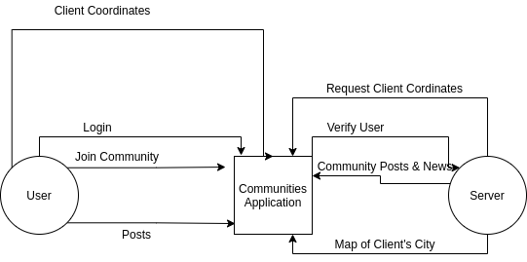
Level 1 Diagram

Slide 6
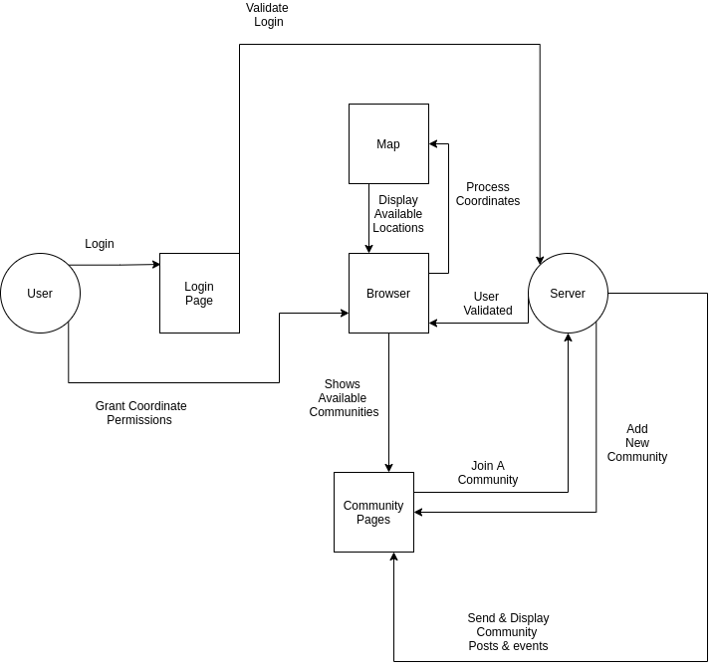
Level 2 Diagram

Slide 7
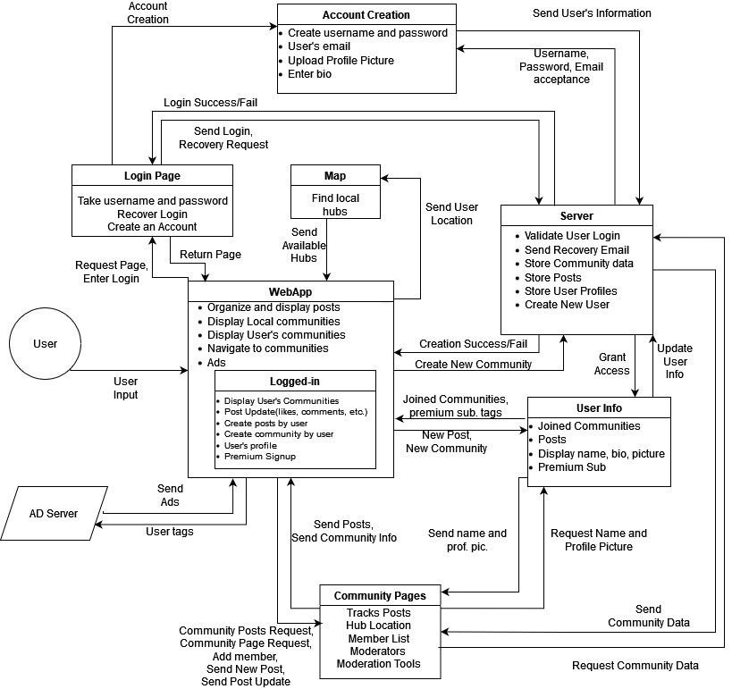
Level 3 Diagram

Slide 8
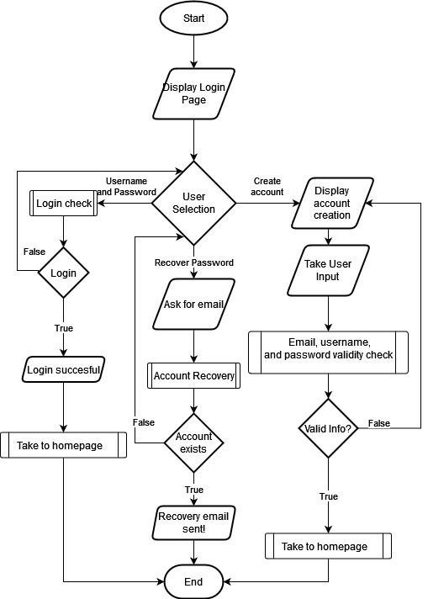
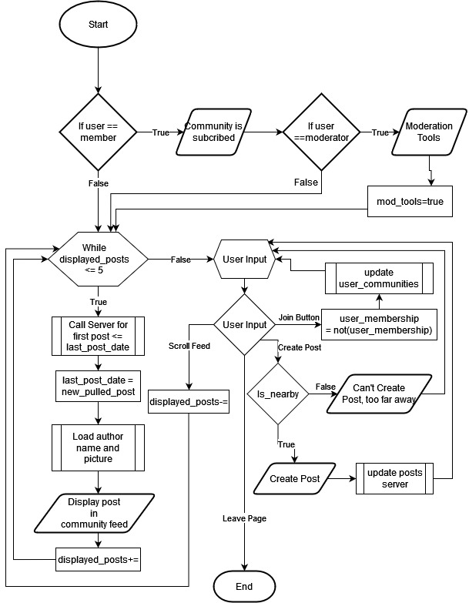
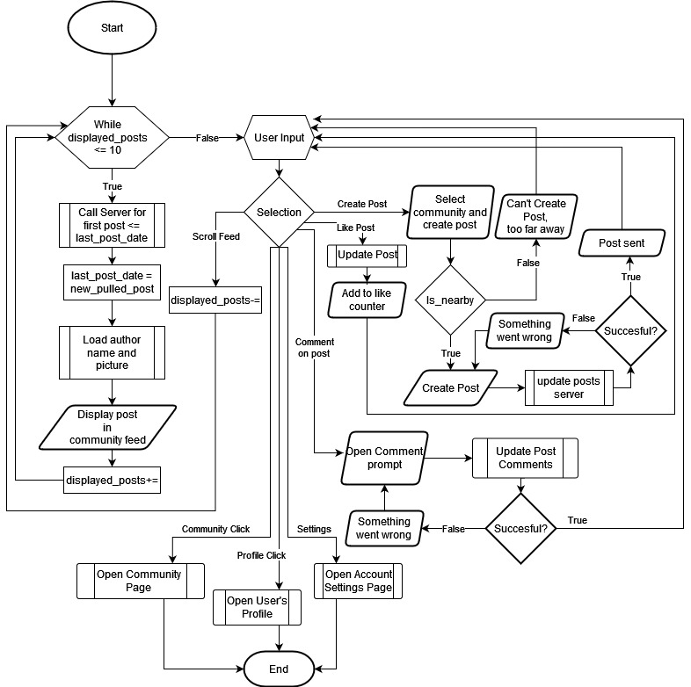
Pseudo Code/Block Diagrams Examples
Login and Account Creation
WebApp Homepage
Community Page

Slide 9
Standards
ISO - Standard password and username encryption.
All sensitive data such as username, password, user geolocation data, will be encrypted.
GDPR - Getting permission to keep user info and no selling
The app needs to use sensitive data so we will maintain user anonymity while serving relevant ads and using the app’s location features
ANSI - Working to generally improve public health through the app
Moderation & fostering of our types of communities.

Slide 10
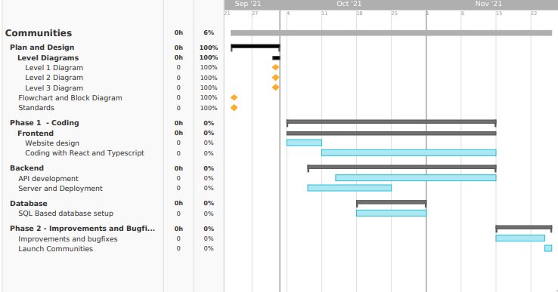
Gantt Chart

Slide 11
Individual Tasks
Will - Database
Christopher - Database
Eric - Frontend & Backend.
Zoe - Server Deployment & Standup
Mason- Geolocation API Implementation
Rishabh - Frontend & Full Stack
Version Control: Github

Slide 12
Conclusion
Provide ease connecting with others with similar interests by providing them a platform.
Encourage participation in local communities through gamification.
We have held meetings to define development goals and draw in expectations.
Task have been assigned and spaced to maintain reasonable expectations and progress.
Our project should revolutionize the social media field

